Slide 1
AIC Presentation
What is the influence of landscape attributes on Virginia
opossum density? (Bernasconi et. al 2020)
Influence of landscape attributes on Virginia opossum density - Bernasconi - 2022 - The Journal of Wildlife Management - Wiley Online Library. (n.d.). . https://wildlife.onlinelibrary.wiley.com/doi/full/10.1002/jwmg.22280.
Deandre Gutierrez, Maggie Carroll, Megan Galenski, Kristen Bashen

Slide 2
Response Variable and Predictors
Response variable: Density of Opossum populations
Predictors: Individual trap probability of capture, spatial scale of detection, land cover type, intercept model, sex, trap effect, and year

Slide 3
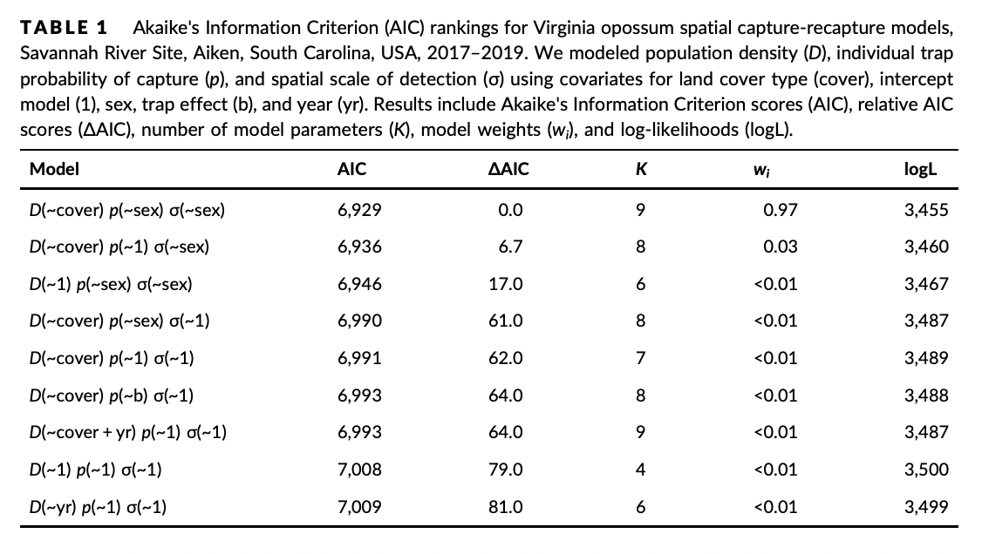
AIC Table

Slide 4
Important Models
The model representing D(~cover) p(~sex) σ(~sex)
The model representing D(~cover) p(~1) σ(~sex)

Slide 5
Concluding Remarks
The top model (D(~cover) p(~sex) σ(~sex)) had land cover type as a predictor of opossum density and sex as a predictor of probability of capture and spatial scale parameter
The next highest ranked model included land cover as a predictor of density and sex as a predictor of the spatial scale parameter

